Slide 1


Interpreting Ecological Niche Modeling
University of Florida

Slide 2
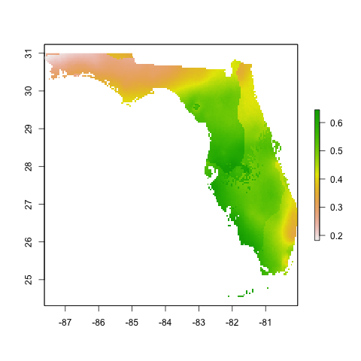
Interpreting ENMs
Step 1: Look at the output

Slide 3
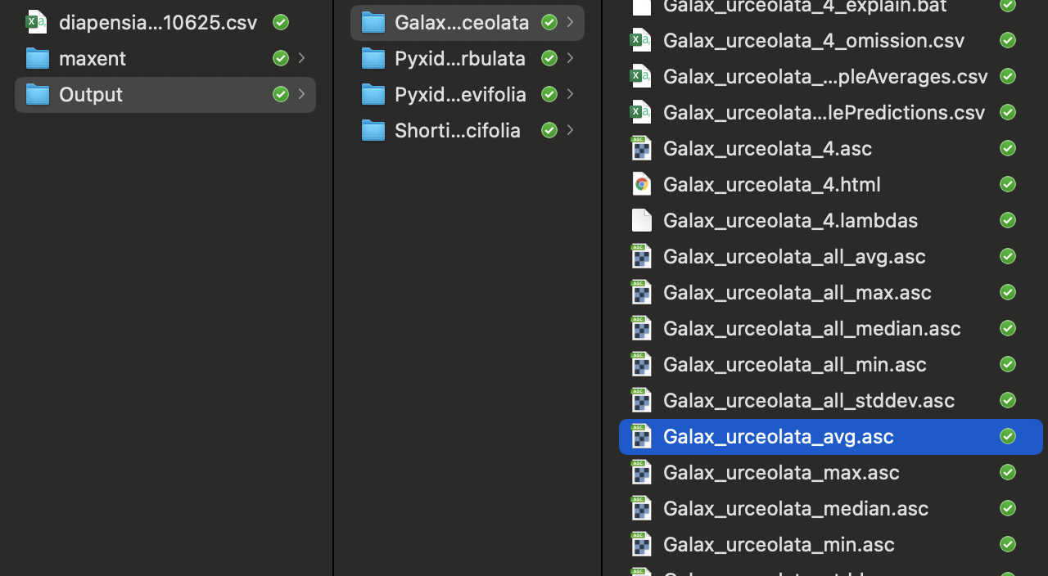
Interpreting ENMs
Step 1: Look at the output
We will use this average file for all other analysis

Slide 4
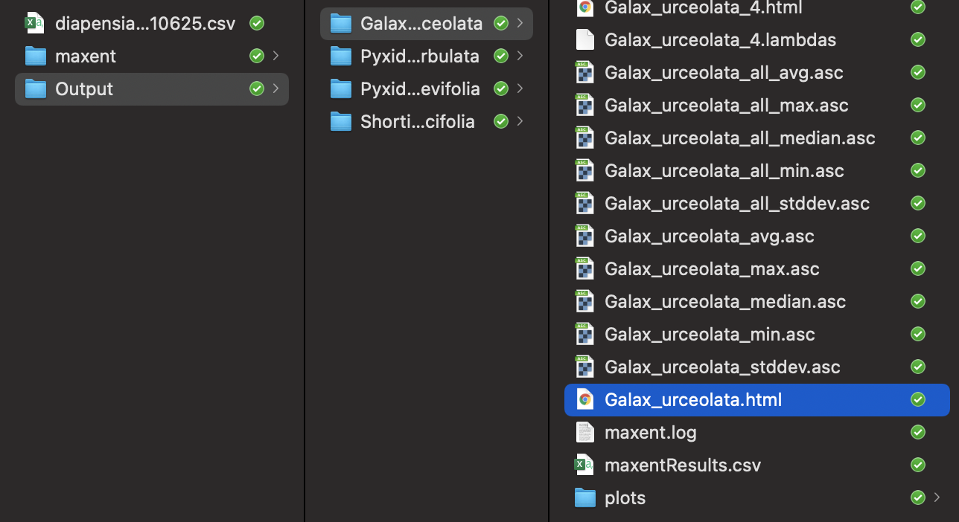
Interpreting ENMs
Step 1: Look at the output
But first, lets make sure the model is good!

Slide 5
Interpreting ENMs
Step 1: Look at the output
Step 2: Evaluate the models

Slide 6
Interpreting ENMs
Step 1: Look at the output
Step 2: Evaluate the models
How well can the model discriminate between occurrence points and background points? e.g., AUC

Slide 7
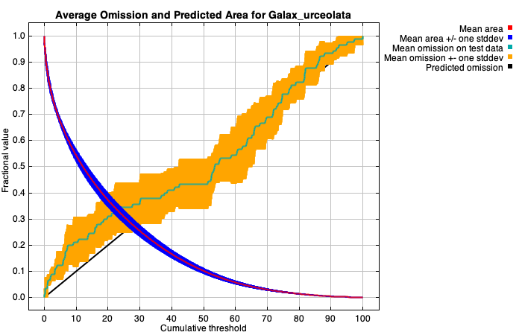
Model Statistics
The test omission rate and predicted area as a function of the cumulative threshold
Omission:
the proportion of a given sample of actual presences that have probabilities of occurrence (or habitat suitability values) below a binarization threshold.
Omission rate should be close to the predicted omission

Slide 8
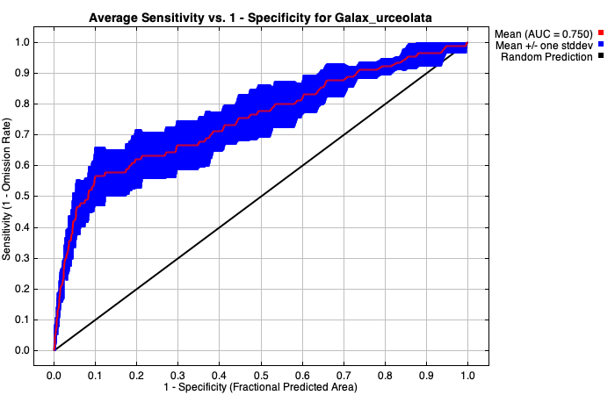
Model Statistics
Area under the curve (AUC) of the Receiver Operating Characteristic (ROC) curve
Too low!!
AUC should be over 0.8

Slide 9
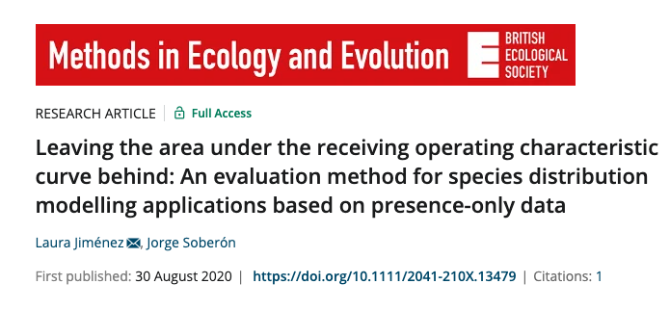
Model Statistics

Slide 10
Model Statistics
 | Method |  | Citation
How significant is the model? | Partial ROC, AUC | higher > 0.80 | Peterson, Papes, & Soberón. 2008.
How well models created with training data predict test occurrence | Omission Rate | lower ≤5% | Anderson, Lew & Peterson, 2003
How complex is the model? | AICc, delta AICc, and AICc weights | lower ≤2 | Warren, Glor & Turelli, 2010
ROC = receiver operating characteristic
AUC = area under the curve
AIC = Akaike information criterion
AICc = AIC for a small sample size
Cobos et al. 2019. kuenm: an R package for detailed development of ecological niche models using Maxent. PeerJ.

Slide 11
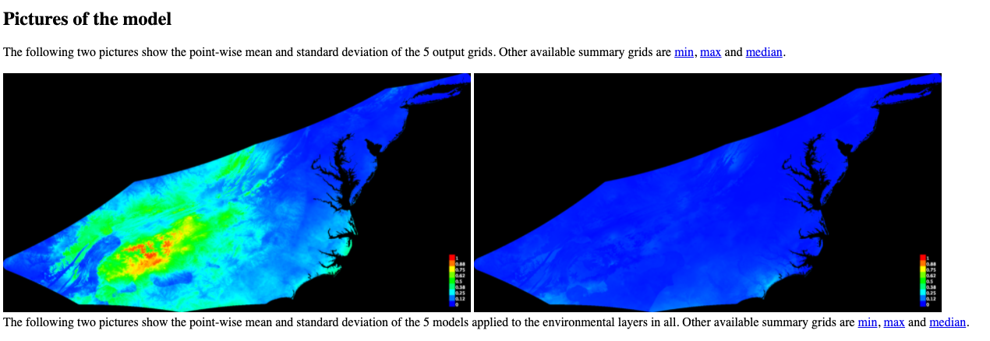
Pictures of the Model

Slide 12
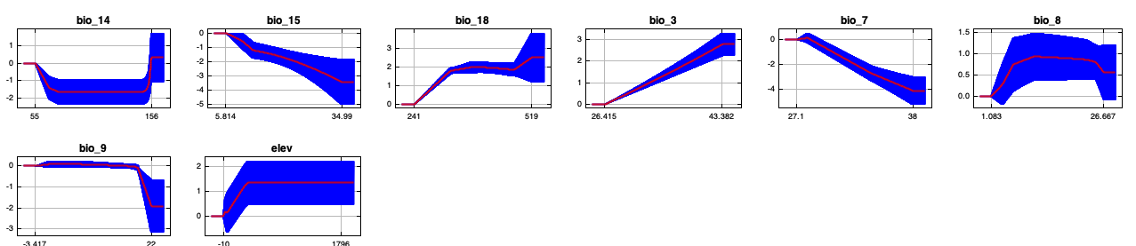
Response Curves
PC score of suitability
Response curves show how each environmental variable affects the Maxent prediction

Slide 13
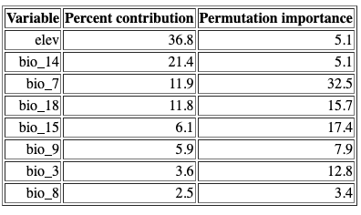
Variable Contribution
For this model, we found the largest percent contribution with elevation (36.8%), followed by precipitation of driest month (21.4%) and temperature annual range (11.9%).

Slide 14
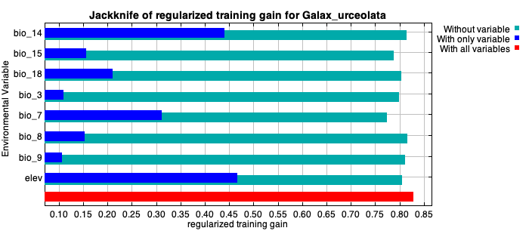
Variable Performance
Shows the importance of variables

Slide 15
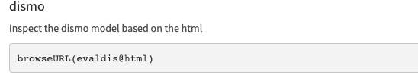
05 Continued
View an html output for models made with dismo

Slide 16
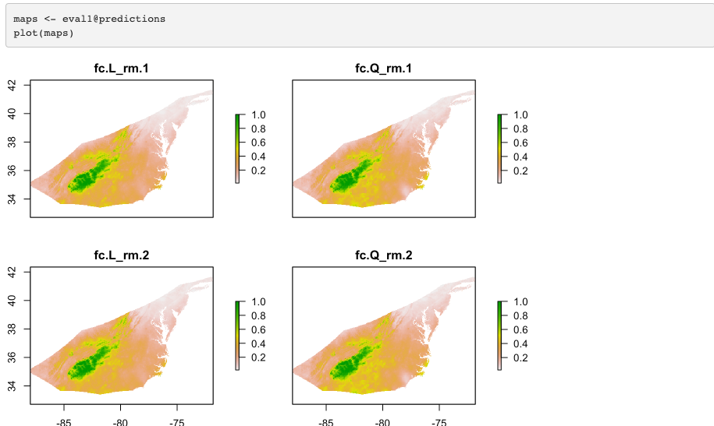
ENMeval – Visualize

Slide 17
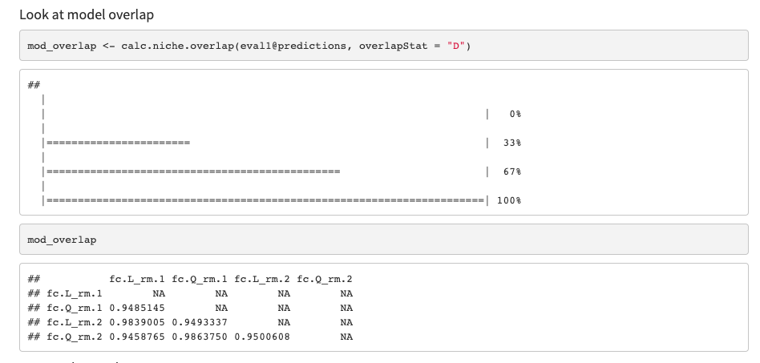
ENMeval – Model Overlap

Slide 18
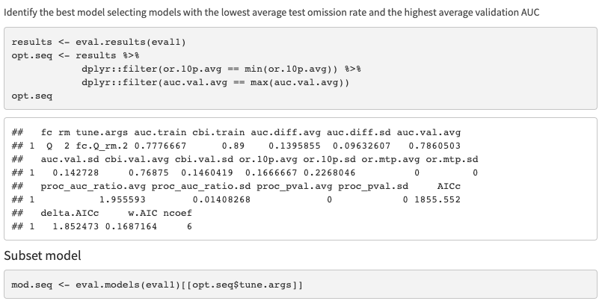
ENMeval – Select Best Model

Slide 19
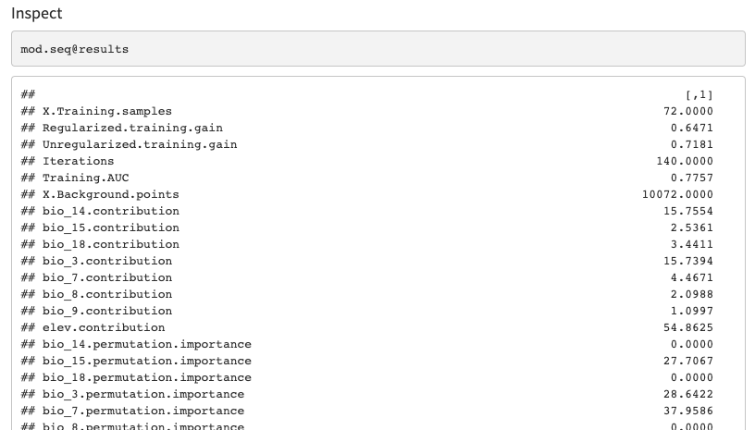
ENMeval – Inspect

Slide 20
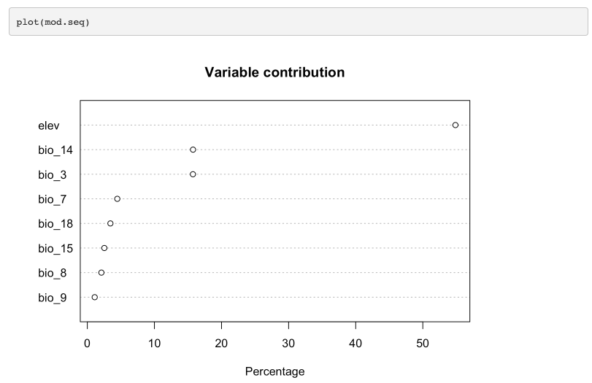
ENMeval – Variable Contribution

Slide 21
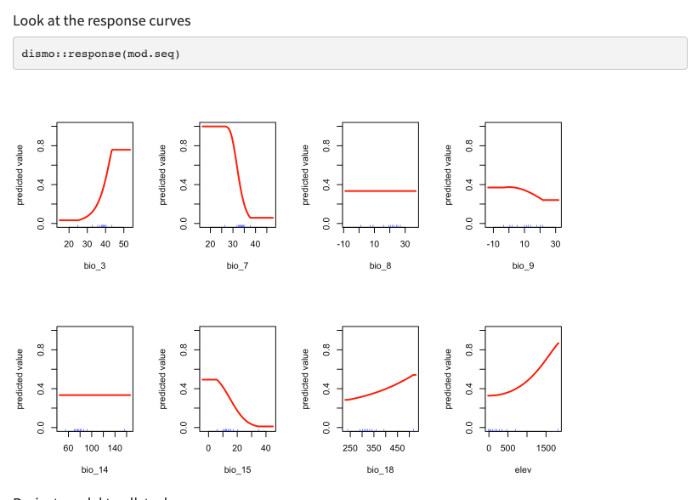
ENMeval – Response curves

Slide 22
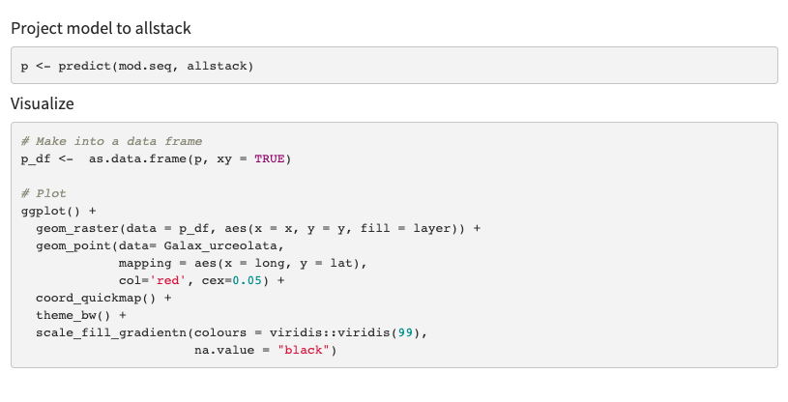
ENMeval – Project and Plot

Slide 23
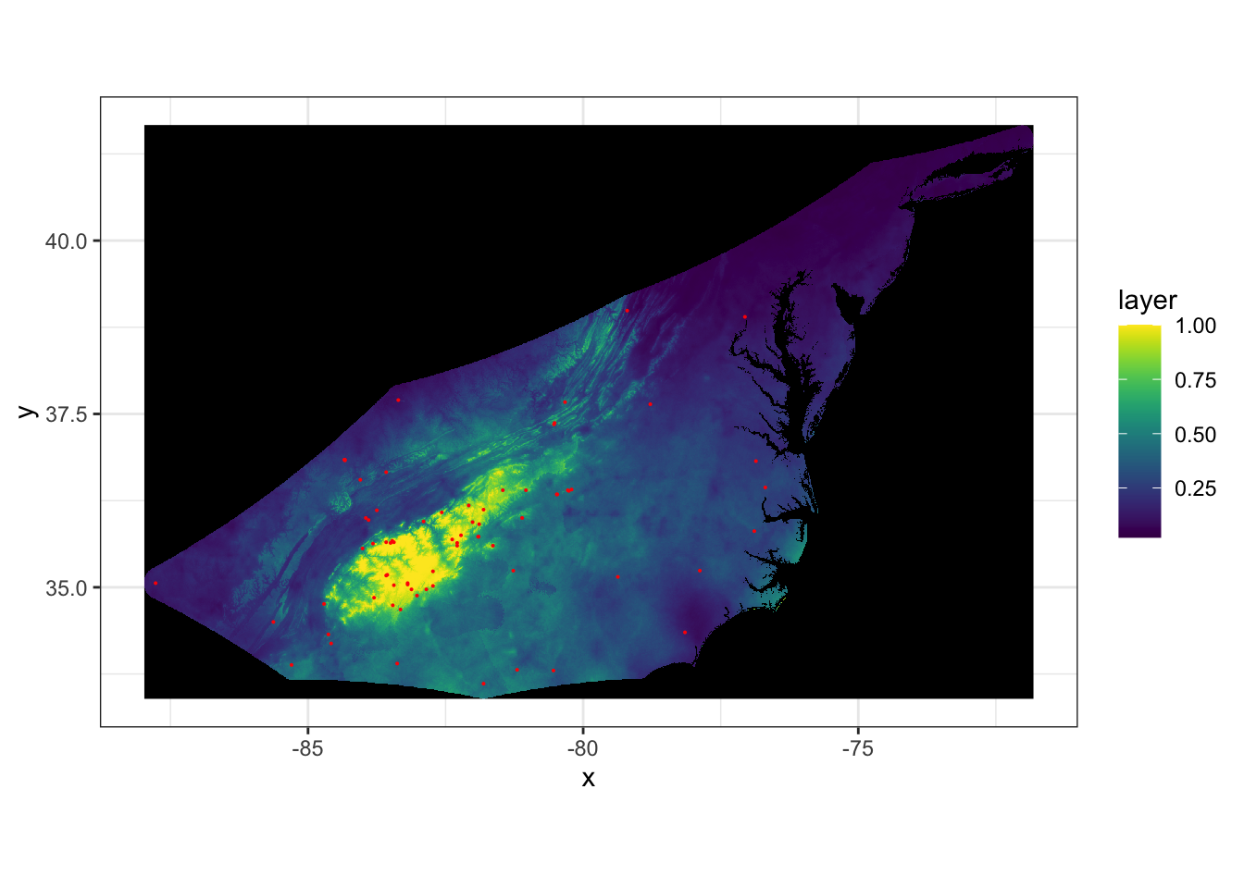

Slide 24
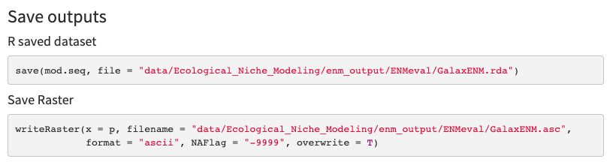
ENMeval – Save Model

Slide 25
Interpreting ENMs
Step 1: Look at the output
Step 2: Evaluate the models
Step 3: Additional Analysis

